Slide 1

Classes

Slide 2
static keyword

Slide 3
Using classes will allow us to implement:

Slide 4
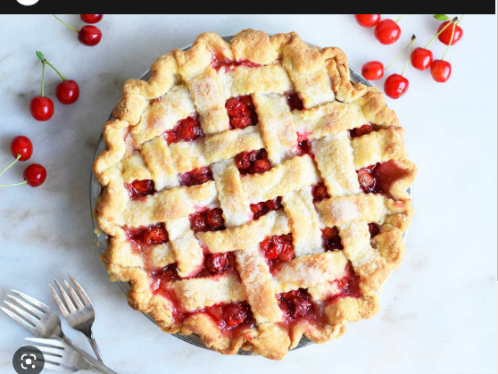

Slide 5
OOPs A PIE
Stands for: A - abstraction
P - polymorphism
I - inheritance
E - encapsulation

Slide 6
OOPs A PIE
Stands for: A - abstraction
P - polymorphism
I - inheritance
E - encapsulation

Slide 7

4 Pillars of Object Oriented Programming
Abstraction
Polymorphism
Inheritance
Encapsulation
*These four pillars revolve around classes!

Slide 8
Classes
-Classes are the cornerstone of object oriented programming

Slide 9
Classes
Allow us to create objects
C# is an OBJECT oriented programming language

Slide 10
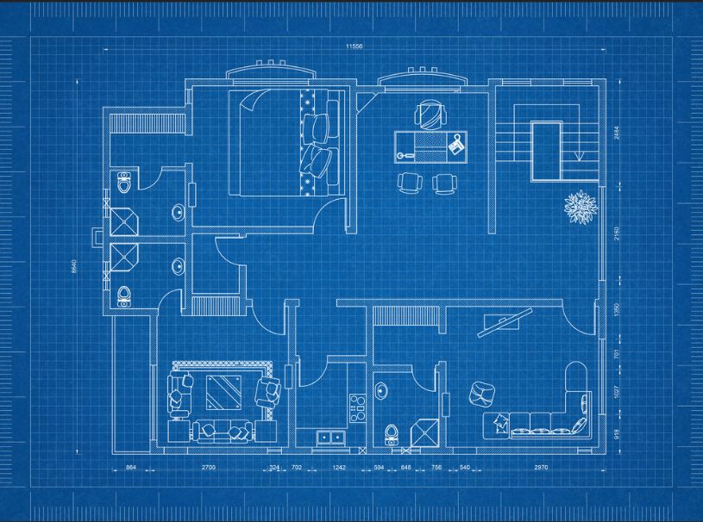
Classes are like a Blueprint

Slide 11
House
Bedrooms
Bathrooms
Kitchen
Pool

Slide 12
Class members
Fields
Properties
Methods
Constructors

Slide 13
Required
Roof
Plumbing
Walls
etc

Slide 14
Required
Class keyword
Class name
Scope

Slide 15
Optional
Pool
Media Room
Formal Dining

Slide 16
Optional
Access Modifier
Fields
Properties
Methods
Constructor

Slide 17

Example of a Class
public class Dog
{
public Dog() // Constructor
{
}
private int _numberOfLegs; // Field
public string Name { get; set; } // Property
public void Speak() // Method in the class
{
Console.WriteLine(Name);
}
}
In this class we have a:
Constructor
Field
Property
Method

Slide 18
Field
public class Dog
{
private int _numberOfLegs; // Field
}
Like a variable, but belongs to the class
It is declared directly inside a class
Can access it through methods
It has:
Access modifier
Type
Variable name

Slide 19
Property
public class Dog
{
public string Name { get; set; } // Property
}
Allows us to “get” and “set” information
Get → Read
Set → Write

Slide 20
Full Methods
private string _dogName;
public string GetDogName()
{
return _dogName;
}
public string SetDogName(string dogName)
{
_dogName = dogName;
}
Lots of lines!

Slide 21
Full Property
private string _dogName;
public string DogName()
{
get {
return _dogName;
}
set
{
_dogName = value;
}
}

Slide 22
Properties
private string _dogName;
public string DogName()
{
get { return _dogName };
set {_dogName = value};
}

Slide 23
Properties
private string _dogName = “User Name”;
public string DogName()
{
get { return _dogName };
set {_dogName = value };
}

Slide 24
Properties
public string Name { get; set; }
Auto-Implemented Properties
-Use Pascal Casing

Slide 25
Properties
public string Name { get; set; } = “User Name”
Auto-Implemented Properties
-How to set a default value

Slide 26
Shortcut
public class Dog
{
public Dog() // Constructor
{
}
private int _numberOfLegs; // Field
public string Name { get; set; } // Property
public void Speak() // Method in the class
{
Console.WriteLine(Name);
}
}
Property : prop + tab + tab

Slide 27
Constructor
public class Dog
{
public Dog() // Constructor
{
}
}
When we instantiate a class, its constructor is called.
It is a special member method
No return type
Has same name as the class

Slide 28
NOTE:
public class Dog
{
public Dog() // Constructor
{
}
private int _numberOfLegs; // Field
public string Name { get; set; } // Property
public void Speak() // Method in the class
{
Console.WriteLine(Name);
}
}
Macs will automatically create a default constructor upon creation of a class
Windows will not automatically make one

Slide 29
Shortcut
public class Dog
{
public Dog() // Constructor
{
}
private int _numberOfLegs; // Field
public string Name { get; set; } // Property
public void Speak() // Method in the class
{
Console.WriteLine(Name);
}
}
Constructor: Ctor + Tab + Tab

Slide 30

You NEED a constructor to “build”/make an object
If you don’t make one, it will default to using the default constructor.

Slide 31
There a Two Types of Constructors
Default
Custom

Slide 32
Default Constructor
public class Dog
{
public Dog() // Constructor
{
}
}
No parameters

Slide 33
Custom Constructor
public class Dog
{
public Dog(string name, string breed)
{
Name = name;
Breed = breed;
}
public string Name { get; set; } // Property
public string Breed { get; set; } // Property
}
You define it yourself
Has parameters
Benefit over Default Constructor:
-Allows you to set values upon creation of an object

Slide 34
Optional: Access Modifier
public class Dog
{
public Dog() // Constructor
{
}
private int _numberOfLegs; // Field
public string Name { get; set; } // Property
public void Speak() // Method in the class
{
Console.WriteLine(Name);
}
}
If you do not specify, classes will default to internal, and methods will default to private

Slide 35
Optional: Constructor
public class Dog
{
//NO constructor written out
private int _numberOfLegs; // Field
public string Name { get; set; } // Property
public void Speak() // Method in the class
{
Console.WriteLine(Name);
}
}
If we do not write out a constructor, it will use the default constructor!
Notes:
If we do not specify a constructor, the C# compiler will use the built-in default constructor

Slide 36
Optional: Constructor
public class Dog
{
public Dog() // Constructor
{
}
}
If we do not write out a constructor, it will use the default constructor!

Slide 37
Constructor Overloading
public class Dog
{
public Dog() // Default
{
}
public Dog(string name, string breed) //Custom
{
Name = name;
Breed = breed;
}
}
Can use both default and custom – however, you must explicitly write out both
(if you just write out the custom, it won’t let you use the default)

Slide 38
Constructor
Dog dog1 = new Dog() // Default
Dog dog2 = new Dog(“Frassy”, “Lab”); //Custom
Just like methods – How does it know which constructor to invoke?

Slide 39
Like Method Overloading!
public class Dog
{
public Dog() // Default
{
}
public Dog(string name, string breed) //Custom
{
Name = name;
Breed = breed;
}
}
It knows which constructor to invoke based on the parameters

Slide 40
Classes are Templates!
public class Dog
{
public Dog() // Constructor
{
}
private int _numberOfLegs; // Field
public string Name { get; set; } // Property
public void Speak() // Method in the class
{
Console.WriteLine(Name);
}
}
This is not an actual dog

Slide 41

How do we create a dog?

Slide 42

How to: Create a dog
Dog dog1 = new Dog(); //this is an instance of a dog
Dog dog2 = new Dog(); //this is our second dog
//We have TWO objects or TWO dogs
Dog 1:
Dog 2:

Slide 43
How to: Create a dog
Dog dog1 = new Dog(); //this is an instance of a dog
Dog dog2 = new Dog(); //this is our second dog
//We have TWO objects or TWO dogs
//Instance == Object
Dog 1:
Dog 2:

Slide 44
Our “dog” has access to:
public class Dog
{
public Dog() // Constructor
{
}
private int _numberOfLegs; // Field
public string Name { get; set; } // Property
public void Speak() // Method in the class
{
Console.WriteLine(Name);
}
}
- Everything in this class

Slide 45
Just like lists!
List<int> myList = new List<int>();
Dog dog1 = new Dog();
-Just like we instantiate a list, we can instantiate a class

Slide 46
Initialize
List<int> myList = new List<int>() { 1, 2, 3};
Dog dog1 = new Dog() {Name = “Sassy”, Breed = “Lab” };
Just like we initialize a list, we can initialize a class

Slide 47
Ways to initialize members members a class
Dot notation
Object initializer syntax
Custom constructor

Slide 48
Dot Notation
Dog dog1 = new Dog(); // instance
dog1.Name = “Sassy”; //Setting the property
dog1.Breed = “Lab”; //Setting the property
Dog dog2 = new Dog(); // instance
dog2.Name = “Frassy”; //Setting the property
dog1.Breed = “Lab”; //Setting the property
This is often used after creating an object using the default constructor.

Slide 49
2. Object Initializer Syntax
Dog dog1 = new Dog(){Name = “Sassy”, Breed = “Lab”};
Dog dog2 = new Dog(){Name = “Frassy”, Breed = “Lab”};
Object initializer syntax is a way to initialize an object and its properties at the time of creation without explicitly invoking a constructor for each property.

Slide 50
2. Object Initializer Syntax
Dog dog1 = new Dog()
{
Name = “Sassy”,
Breed = “Lab”
};
Dog dog2 = new Dog()
{
Name = “Frassy”,
Breed = “Lab”
};
You can spread it out so it’s more readable

Slide 51
3. Custom Constructor
public class Dog
{
public Dog(string name, string breed)
{
Name = name;
Breed = breed;
}
public string Name { get; set; } // Property
public string Breed { get; set; } // Property
}
**Reminder what a custom constructor looks like

Slide 52
3. Custom Constructor
Dog dog1 = new Dog(“Sassy”, “Lab”); // instance
How to invoke a custom constructor
You can immediately set values when you create an instance

Slide 53
Instance Method
Dog dog1 = new Dog(); //this is an instance of a dog
dog1.Speak(); //call the method for dog1
instanceName.MethodName();
Notes:
Classes allow us to make instance methods

Slide 54
Classes Demo

Slide 55
Pinning VS Community 2022 to Taskbar

Slide 56
Creating a New Project in VS Community 2022

